Slide 1


Slide 2
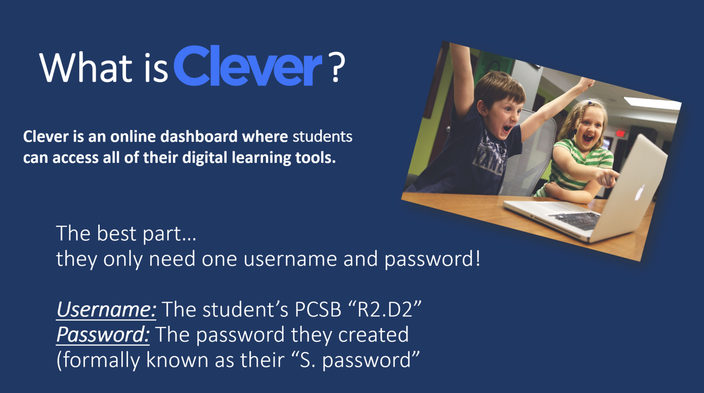
Notes:
All of your children should know this information by heart. Any time that they log into a computer at school they must use this username and password.

Slide 3
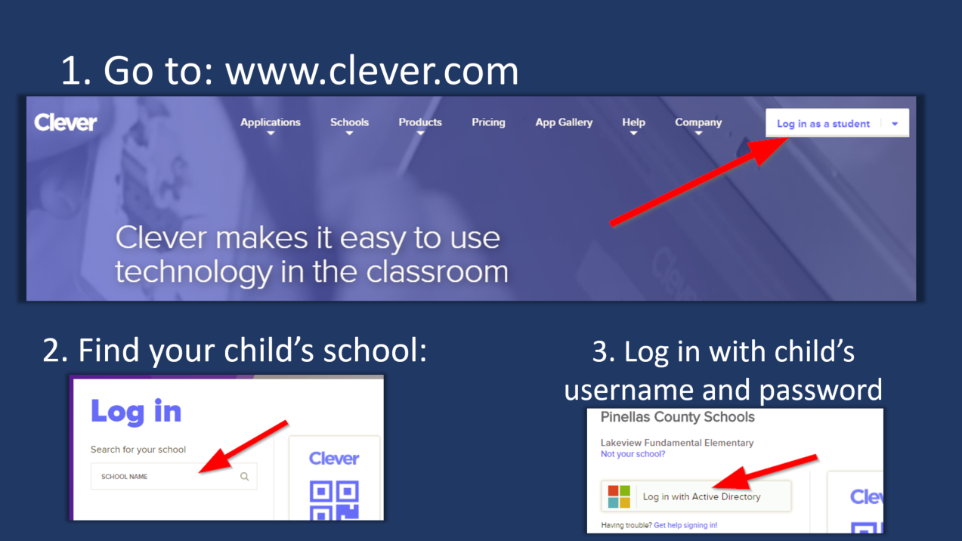
Notes:
All of your children should know this information by heart. Any time that they log into a computer at school they must use this username and password.

Slide 4


Slide 5
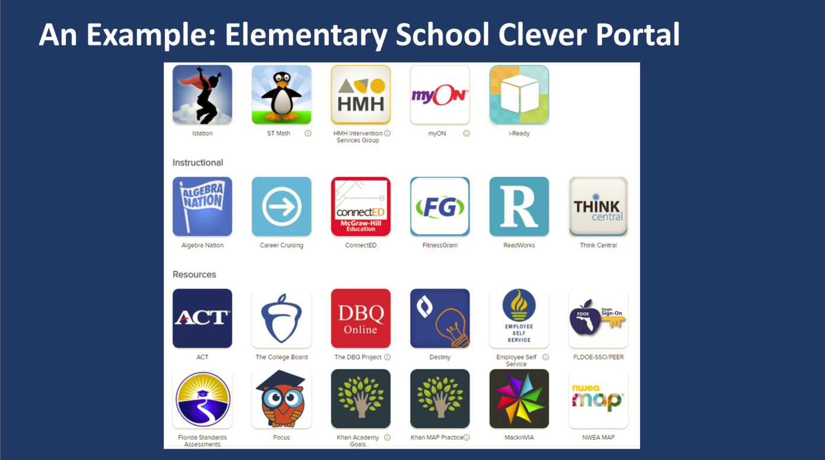

Slide 6
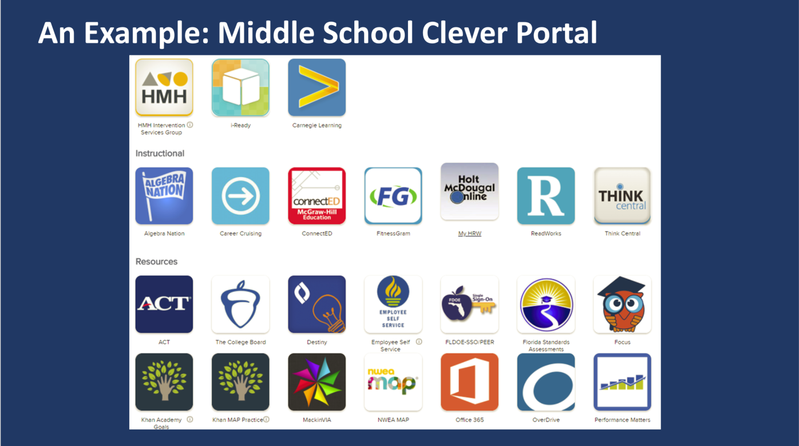

Slide 7
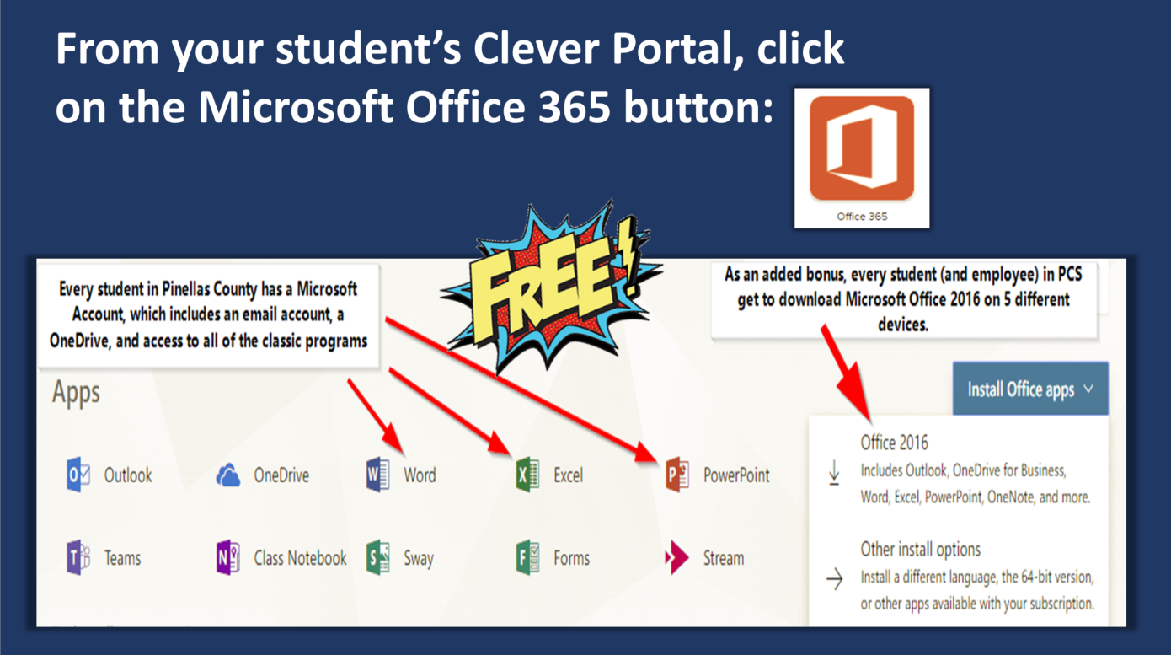

Slide 8
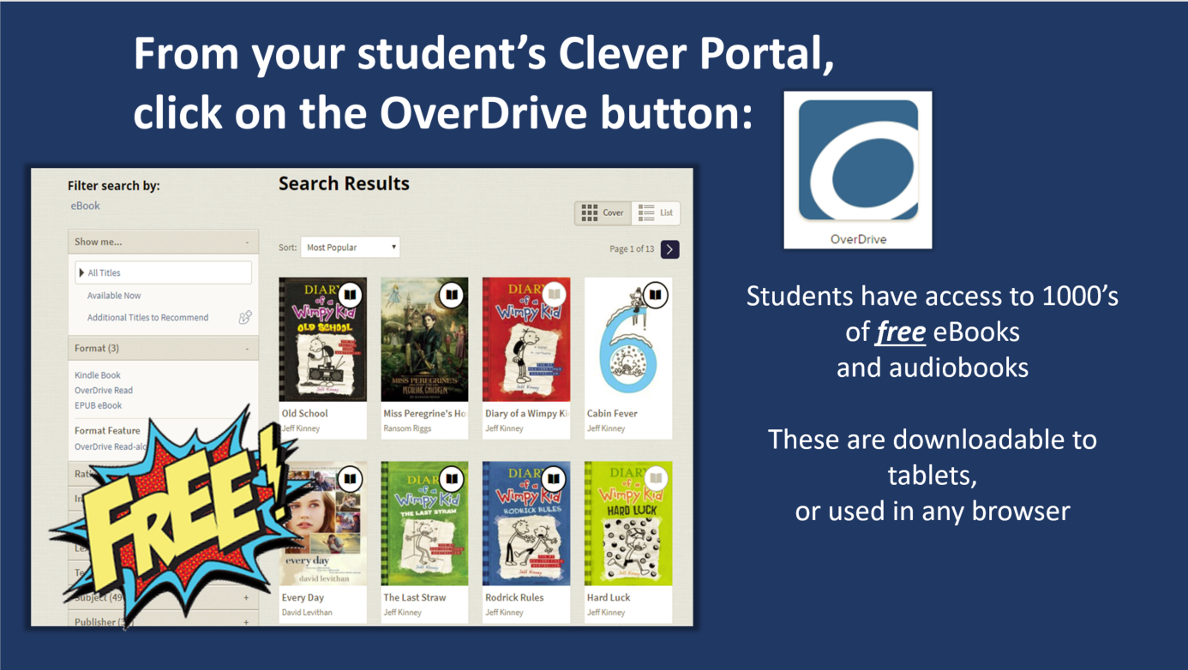

Slide 9


Slide 10


Slide 11


Slide 12


Slide 13
